Slide 1
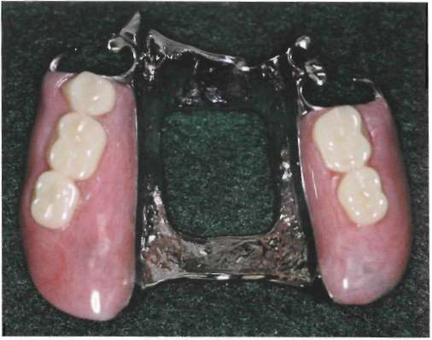
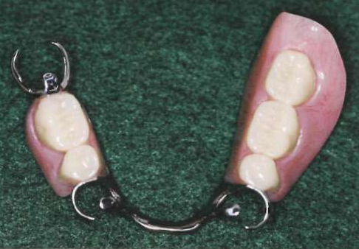
DENTURE BASE CONSIDERATIONS
Dr. Sunit Jurel
Assistant Professor
Dept.Of Prosthodontics

Slide 2
Contents..
DENTURE BASE CONSIDERATIONS
Definition
Requirements
Functions
Types
a,Plastic
b,Metal
Tooth supported partial denture base
Distal extension denture base
Methods of attaching denture base
Methods of attaching artificial teeth
Relining

Slide 3
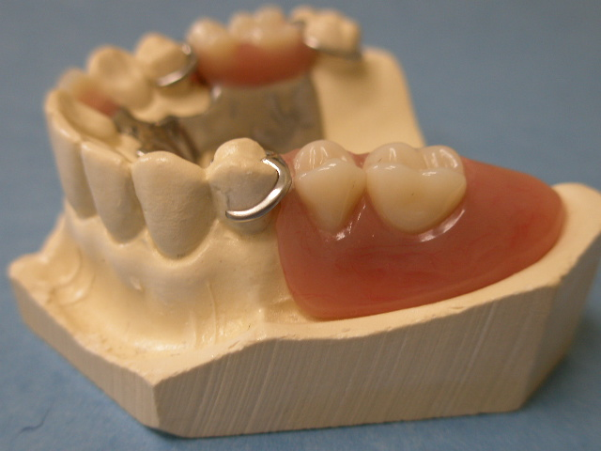
Definition
“Denture base is that part of the removable partial denture which rests on oral mucosa and to which teeth are attached”.

Slide 4
REQUISITES FOR IDEAL DENTURE BASE
Accuracy of Adaptation To Tissues With Low Volume
Change
Dense non irritating surface capable
of receiving & maintaining a good finish.
Biocompatible
Thermal conductivity
Low specific gravity – Lightness in mouth
Esthetic

Slide 5
Dimensional stability
Sufficient strength – Resistance to fracture
/distortion- Resist deformation
Self cleansing
Low Cost
Potential for future relining

Slide 6
FUNCTIONS
Esthetics
Support and retain artificial teeth
Assist in transfer of occlusal forces directly to abutment teeth through rests.
Prevent vertical and horizontal migration of remaining natural teeth.
Eliminate undesirable food traps.
Stimulates the underlying tissue.

Slide 7
TYPES
Plastic -
Acrylic
Polystyrene
Valplast
Metal -
Gold
Co-Cr
Titanium
Vitallium

Slide 8
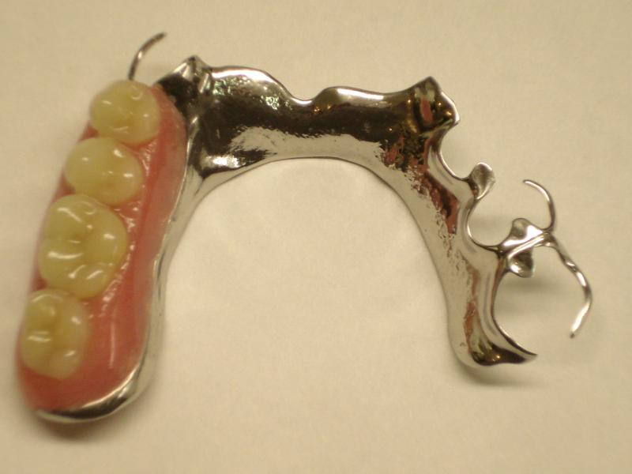
METAL BASE
Indications
Tooth supported partial dentures
Inadequate interarch space
Structural details
Designed with optimum extension
Thinner base than plastic resin
Avoid sharp margins

Slide 9
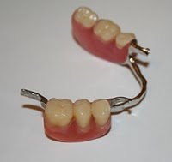
Metal Base - Advantages
Accuracy and Permanence of form
Comparative tissue response
Thermal conductivity
Weight & Bulk

Slide 10
Accuracy and permanence of form
Cast more accurately than denture resins and maintain their accuracy of form without change in mouth.
Need for an additional PPS eliminated entirely.
Metal base provides intimacy of contact
retention of denture prostheses.

Slide 11
Comparative tissue response
Metal base naturally cleaner than an acrylic resin base.
Bacteriostatic activity – ionization oxidization of metal base.

Slide 12
Thermal conductivity
Temperature changes transmitted through metal to the underlying tissues help to maintain health of that tissue.
Patient acceptance.
Denture base resins – insulating property

Slide 13
Weight and bulk
Metal alloy may be cast thinner than acrylic resin and still have adequate strength.

Slide 14
Metal Base- Disadvantages
Unaesthetic
Enhancement of retention not possible
Relining difficult
Restoration of normal facial contour can not be achieved

Slide 15
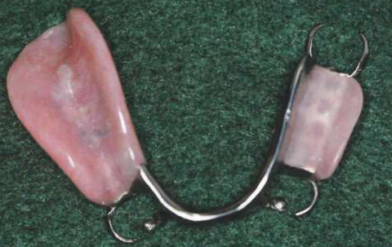
Acrylic denture base
Indications
Extension base partial denture
Long span edentulous ridges
Relining
Contour restoration

Slide 16
Certain situations demands use of acrylic denture base-
Extreme loss of residual alveolar bone.
Fullness to denture base to restore facial
contours.
Esthetics

Slide 17
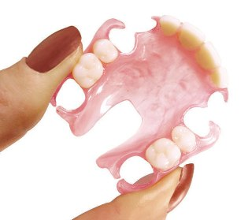
VALPLAST
Flexible denture base
resin ideal for partial dentures.
Esthetics
functional alternative to traditional cast
metal based removable partial dentures.

Slide 18
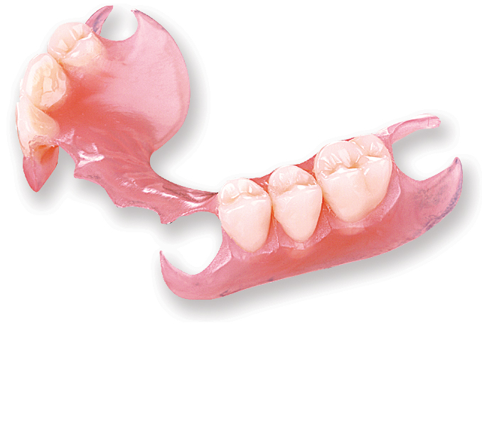
Biocompatible nylon and thermoplastic
resin-flexibility and stability.
Color, shape and design of valplast partials blend with natural appearance of gingiva making prostheses nearly invisible.
Strenght of valplast resin doesn’t require a metal framework-eliminates metallic taste.
Enables partial to be fabricated thin enough with non metallic clasps.

Slide 19
DENTURE BASE …..TYPES
Tooth Supported Partial Denture Base
Distal Extension Partial Denture Base

Slide 20
Tooth Supported Partial Denture Base
Denture base is primarily a span b/w two abutments supporting artificial teeth.
Occlusal forces transferred to
abutments-Rests.
Prevent horizontal migration and
vertical migration of natural teeth .

Slide 21
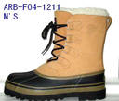
Distal extension partial denture base
Support –primary consideration
Support critical for minimizing
functional movement and
improving prostheses stability.
Snow shoe principle-
broad coverage furnishes the best support
with least load per unit area is principle
choice for providing max support.

Slide 22
Advantages-
Esthetics,
Stimulation of underlying tissue
Relining
Primary retention for RPD –
mechanically by placing retaining elements on abutment teeth.

Slide 23
Secondary retention-
Intimate relationship of denture
base and major connectors.
Adhesion
Cohesion
Atmospheric pressure
Physiological molding of tissue .
Effect of gravity on mandibular denture.

Slide 24
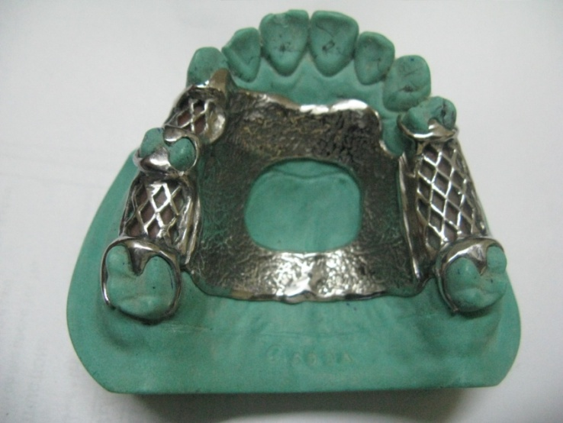
Methods of attaching denture base
Acrylic resin bases attached to partial denture frame work-minor connector designed b/w framework and underlying tissue.

Slide 25
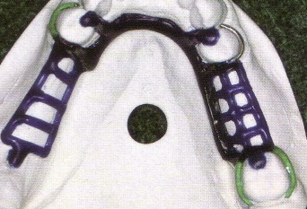
12-14 guage half round wax and 18 guage round wax-ladder like framework rather than mesh pattern.
Not interfere with teeth arrangement-future adjustment
MESH PATTERN/ LADDER
LIKE FRAMEWORK
BEADS & NAIL HEADS

Slide 26
Methods Of Attaching Artificial Teeth
Porcelain/ Resin Artificial Teeth with Resin
Porcelain/ Resin Tube Teeth & Facings Cemented Directly
to Metal Bases
Resin Teeth Processed Directly To Metal Bases
Metal Teeth Cast With Frame Work

Slide 27
Porcelain or acrylic resin teeth attached with acrylic resin
Porcelain teeth, mechanically
retained by acrylic resin denture
base in their diatoric holes and
retention pins.
Acrylic resin teeth retained by
chemical union with acrylic resin of denture base.
Separation occurring b/w acrylic resin and metal .

Slide 28
Porcelain or resin tube teeth and facings cemented directly to metal bases.
Modification of this method is attachment of ready made acrylic resin teeth to the metal base with acrylic resin of same shade(pressing).
Particularly applicable for ant replacements.

Slide 29
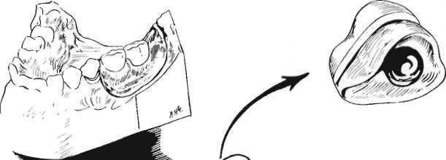

Slide 30
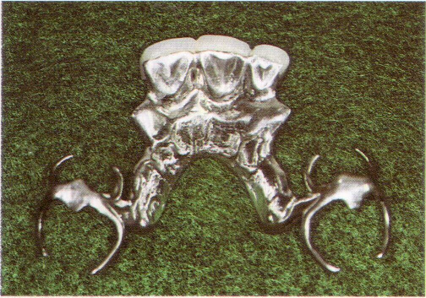
Disadvantages
Difficulties in obtaining satisfactory occlusion.
Lack of adequate contours for functional tongue and cheek contact.
Unesthetic display of metal at gingival margins.

Slide 31
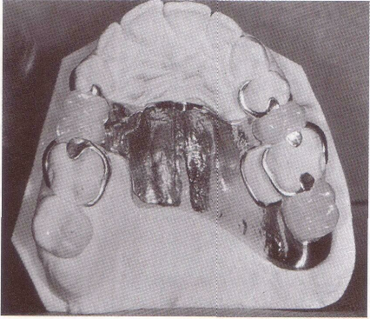
Resin teeth processed directly to metal bases
Occlusal relation established in
mouth and transferred to articulator.
Teeth can be carved or processed
in acrylic resin of proper shade.
Long, short,wide or narrow teeth may be created when necessary to fill spaces.

Slide 32
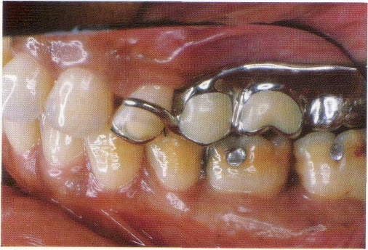
METAL TEETH
Occasionally a second molar tooth may be replaced as part of partial denture casting.
Space too limited for attachment of an artificial tooth.
Should be used only to fill a space and to prevent tooth extrusion.

Slide 33
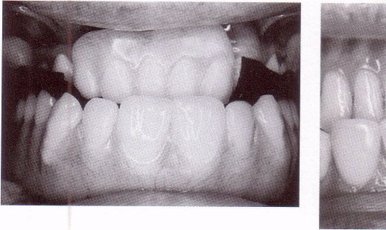
NEED FOR RELINING
Distal extension base differs from tooth supported base-
made of material
relined.
Acrylic resin denture base materials that can be relined.

Slide 34
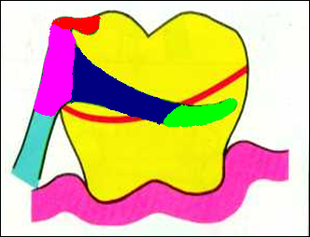
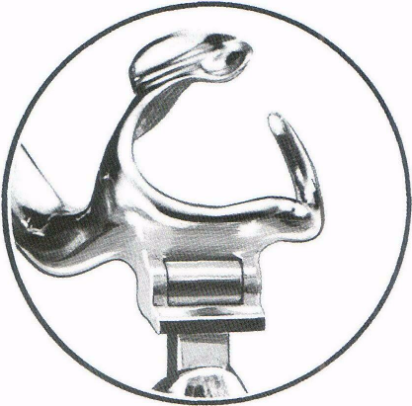
STRESS - BREAKERS
In distal extension situations-rigid connection b/w denture base and supporting teeth account for the base movt. without causing tooth or tissue damage.
Two types of stress breaking design.
Tapered, wrought wire retentive clasp-flexibility.
stress breaking-separating action of retaining elements from denture base

Slide 35
THANK YOU

